Slide 1
HFNY Accreditation 101
Best Practice Standards 7, Performance Indicators, & SharePoint Updates
October 4, 2023
Notes:
Session will be recorded and uploaded to the HFNY website.
We’ll leave time for questions at the end of this session but please feel free to put questions in the chat as we go along, and we’ll work to answer all of them at the end.

Slide 2
Today’s agenda
Self Study - BPS 7
Performance Indicators- connection to Accreditation
GA-5B-Boiler Plate language
SharePoint Updates (folders for BPS 9 & Additional Reports)
Questions
Notes:
Shorter presentation today but we know many of you have started to upload to SharePoint and so we’ll leave lots of time for questions.
Here is the agenda for today. We’ll take a look at self study requirements for BPS 7, share the connection with P.Is & accreditation, share the boiler plate language for GA-5B narrative requirement, updates to SharePoint, and questions.

Slide 3
Accreditation Timeline - updates
Notes:
Here we are in October for 101 number 9. The topic for November is yet to be determined.

Slide 4
BPS 7 – Self-Study Requirements
Policies:
7-1A – Medical/Health Care Provider
7-2A – Immunizations
7-3A – Referrals/Linkages to Health Care & Community Resources
7-4A – Depression Screening
Reports
7-1B, 7-2B (Immunization schedule-upload with report), 7-2C, 7-4B, 7-4C, 7-4D
CA is working on a spreadsheet that will list out all reports required for your self-study with the dates that you’ll need to run for each report. We’ll be sending this to programs the first of week of December. Please do not upload reports into your self study until after 12/10/23.
Narrative for 7-1C - This information is already captured in your Annual Service Report (ASR) & Quarterly Reports Uploading your ASR and quarterly reports in the appropriate folders in SharePoint will cover this requirement.
Notes:
(MS)
Policy 7 drafts went out for feedback and are not finalized yet.
Once finalized and your procedures are approved by your OCFS PCM, they can be uploaded to SharePoint under the policies folder
CHSR is creating a new report- 7-1B to capture all that is required for the self study. That will be ready when you begin uploading reports after 12/10/23
Along with the 7-2B report you’ll also upload the Immunization schedule. There is a link to this schedule in Policy 7-2A in the appendix section
For 7-1 C, HFA is asking for a narrative

Slide 5
BPS 7 – Self-Study Requirements
7-1C – Focus Children with Well-Child Care
In the ASR:
In Quarterly Reports:
Notes:
If programs upload their ASR and Quarterly Reports into their related folders, self-study requirements for this standard will be covered.

Slide 6
Performance Indicators & connection to Accreditation
The PIs can be a great way of making sure your program adheres to HFA’s BPSs.
There is still time for you to make sure data is entered into MIS to meet PIs.
When running the PIs as of 10/11/23, please make sure to use the correct PI detail document.
PTs in PI # 1such as Immunizations, Medical Provider and Well baby visits, ASQs completed or FGPs and referrals for the big 3 are all BPSs that will be scored by HFA.
Same with items such as Retention (PI #2), timing of the first HV (PI # 4), HV rate or case weights (PI # 16).
Trainings (PI #6 and 7) are another example of how the PIs can help you make sure you will have all that is needed for Accreditation.
Even if PI reports are not required by HFA, running them in the MIS will help you write your narrative.
Notes:
CHSR is working an excel document to share with programs. This will be sent out before Dec. 10th, 2023, when programs will begin uploading reports to SharePoint. Let’s look at the document. You’ll see that it lists all reports that need to be uploaded. The corresponding standards are also listed. The highlighted reports are reports that are also run as part of your Performance Indicators.

Slide 7
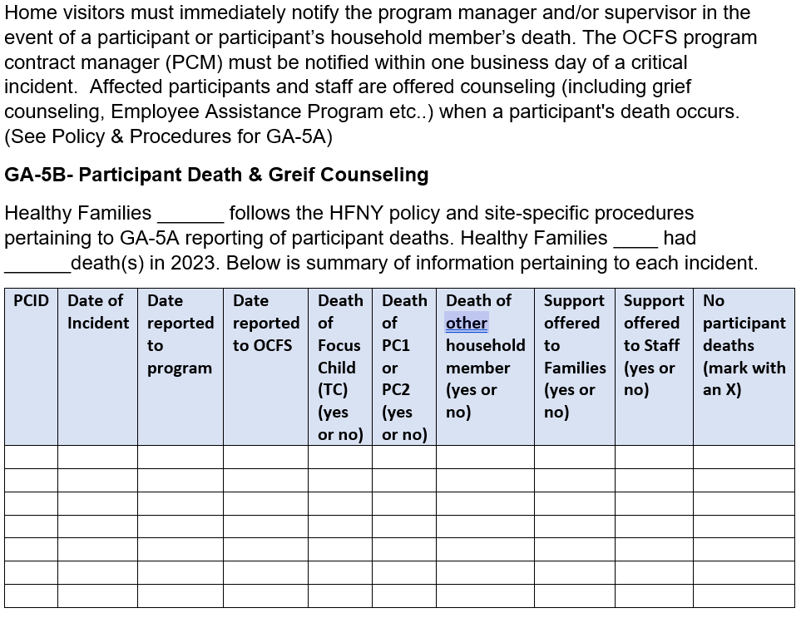
GA-5B-Boiler Plate language
Notes:
GA-5B-Participant Death and Grief Counseling-Self Study requires you to submit a narrative indicating any incidents of participant death that have occurred within the past year.
Submit the Critical Incident Reports on any participant deaths. Ensure the reports are updated to include any additional information on the incident and/or support provided to the family.
We will be adding a separate folder for this information in SharePoint

Slide 8
SharePoint Updates
Subfolders have been added to the Personnel folder to help keep info more visible & organized
We will be working to add subfolders to the Additional Reports folder & adding a folder for GA-5B
This Photo by Unknown Author is licensed under CC BY-NC
Notes:
Subfolders in Personnel are as follows: 9-1A through 9-1D & 9-2

Slide 9
Self Study Submission
What am I submitting January 5th?
Policies and Procedures
Annual Service Review and Equity Plan
Last completed Quarterly Reports for most recent 4 quarters (this will depend on contract start date)
July-2022-2023 quarters – 2nd, 3rd and 4th 2023-2024 1st quarter
September 2022-2023 quarters 2nd, 3rd and 4th and 2023-2024 1st
October 2022-2023 quarters 1-4
December 2022-2023 quarters 1-4
MIS Reports – Begin uploading MIS reports after Dec. 10th, 2023
Personnel/Human Resources info (interview questions, job postings, resumes and staff development plans etc…)
Use Accreditation tool to see breakdown of self study submission by BPS and where to find the info; ASR, Quarterly Reports, MIS reports, HR
Notes:
Your self study will consist of the following information which you will be adding to the SharePoint as you complete these tasks.
Finalized Policies and Procedures (approved by PCM)
Annual Service Review and Equity Plan
Quarterly Reports for the last 4 completed quarters
MIS Reports (Again, CHSR is working on an excel sheet listing of all required reports, and dates to run them for the self study. This will be sent to programs closer to the beginning of December. You will want to run these and upload after December 10th to ensure most recent data for recent practice is provided.
Personnel/Human Resources info-standardized interview questions, job postings, staff resumes, and staff development plans if applicable
Use Accreditation tool to see breakdown of self study submission by BPS and where to find the info; ASR, Quarterly Reports, MIS reports, HR

Slide 10
QUESTIONS??

Slide 11
Questions on Self Study
For questions related to setting up an Outlook account to enable use of SharePoint, please reach out to Claudia Miranda-Julian.
Claudia.Miranda-Julian@ocfs.ny.gov
For questions related to interfacing with SharePoint, please reach out to your accreditation OCFS program contract manager.

Slide 12
Supporting Families
Right From the Start
Questions?
Allison.Contento@ocfs.ny.gov
Melanie.Schraa@ocfs.ny.gov
Suzan.Harry@ocfs.ny.gov

